Slide 1
Moral Injury and Distress in Inclusion Health
John Conolly, June 2023

Slide 2
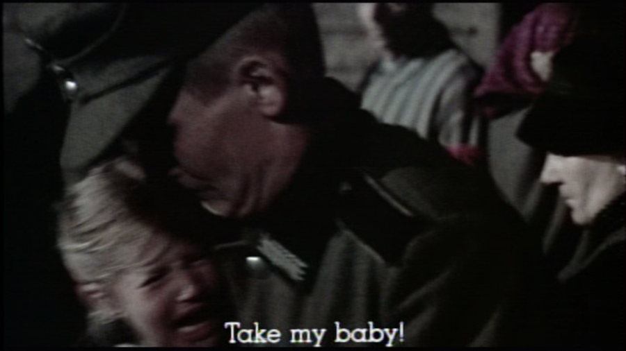
Sophie’s Choice
Scene:
A frightened Polish mother stands in line for the German concentration camps, holding her young daughter while her young son huddles closely against her.
  A rapacious Nazi officer makes some lurid remarks and then
demands that Sophie choose which of her children will survive. Only one. The other will die.
  Sophie protests. She screams. And then… she decides (1).
  The Novel and movie are about how she lives or fails to live with the consequences of that choice.

Slide 3
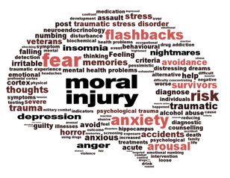
Moral Injury
Refers to
  guilt,
  shame
  contempt and anger
that results from the betrayal, violation or suppression of deeply held or shared moral values (2)

Slide 4
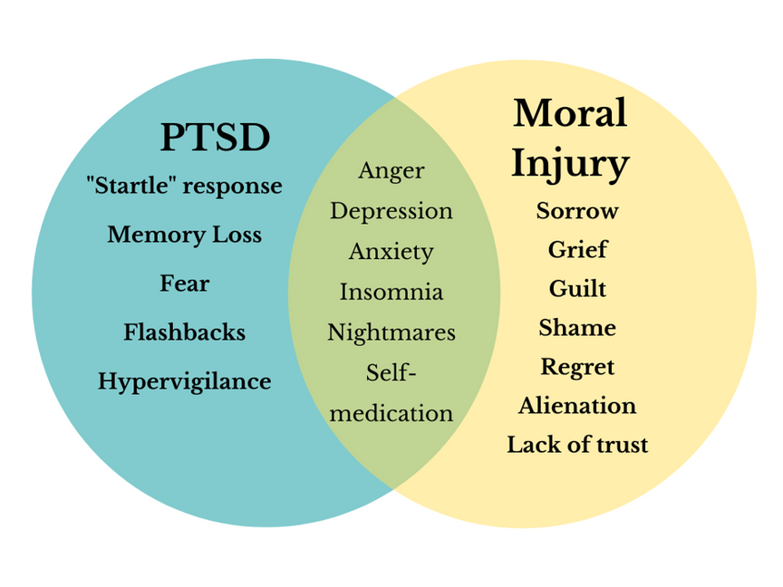
  It is distinct from post-traumatic stress disorder (PTSD), which entails
Not PTSD
the body and mind's adaptation to situations of extreme fear and stress.
  Moral Injury involves a profound sense of broken trust in ourselves,
our leaders, governments and institutions to act in just and morally "good" ways (2).

Slide 5
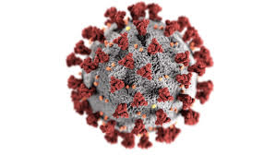
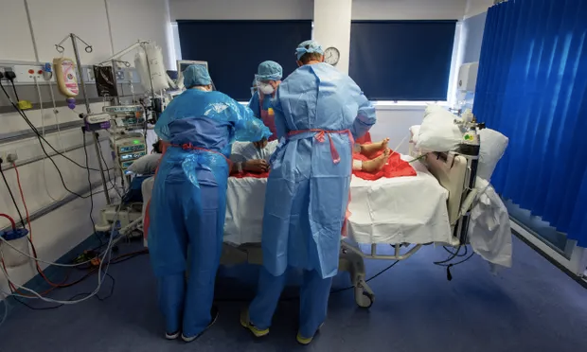
Moral injury in Healthcare
  Moral Injury has also been observed in healthcare workers over the course of the COVID-19 pandemic. With a profound duty to care for others, healthcare workers often hold a deep sense of moral responsibility for the lives of their patients.
  It is difficult enough when faced with constant ‘negative outcomes’ in life and death situations, yet many doctors, nurses and carers also struggled with inadequate resources due to structural problems in the NHS, political calculation and fundamental misunderstandings of the situation by governmental officials.
  In these ways, many may experience what has been described as “the betrayal of what’s right by a person in a position of authority in a high-stakes situation” at institutional levels (2).
NHS staff are suffering from ‘moral injury’, a distress usually associated with war zones
Guardian; Mon 12 Apr 2021
Mariam Alexander

Slide 6
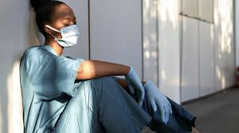
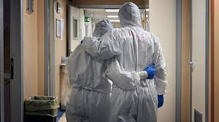
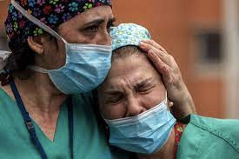
Moral distress in the NHS
  The impact on doctors’ health from moral distress [unease and burnout a long-term precursor to] moral injury can be significant, being linked to severe mental health conditions such as depression and PTSD [like symptoms].
  This is a result of the institutional and resource constraints healthcare staff face, meaning they often cannot provide the high level of care they want and expect to be able to deliver (3).

Slide 7
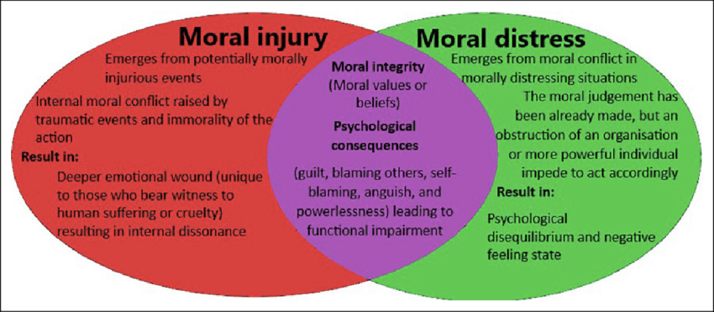

Slide 8
Moral Distress (MD) and Moral Injury (MI) in Inclusion Health Especially
  Fragmented service delivery and budgets
  Fundamental misunderstandings between different parts of Health System
  Fundamental misunderstandings between different Health Professionals
  life and death situations
  inadequate resources
  Multiple complex needs
  Health system in Crisis
  Stigma
  fundamental misunderstandings by governmental officials
  Political calculation

Slide 9
References
https://ew.com/article/2014/04/25/sophies-choice-bluray/ (13.05.23)
2. https://www.durham.ac.uk/research/institutes-and-centres/moral-injury/what-is-moral-injury/( 13.05.23)
3. https://www.bma.org.uk/advice-and-support/nhs-delivery-and-workforce/creating-a-healthy-workplace/moral-distress-in-the-nhs-and-other-organisations (13.05.23)
4. https://www.researchgate.net/figure/Interplay-between-moral-injury-and-moral-distress_fig1_348416151 ( 02.06.23)

