Slide 1

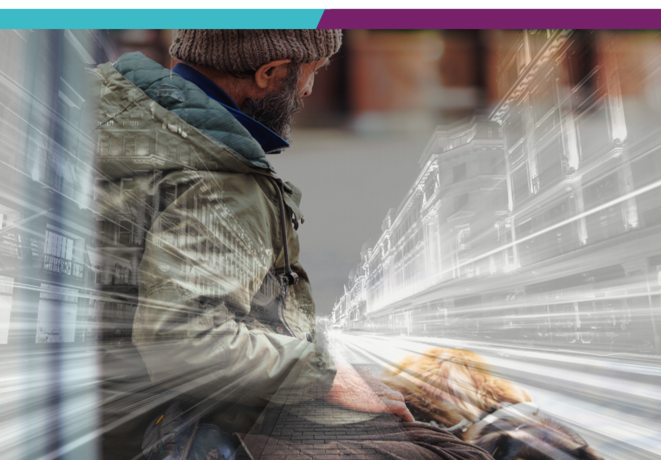

Using a
‘Psychologically Informed Environments’ Model to Support Staff Wellbeing in the Workplace
Dr Emma Williamson
Consultant Clinical Psychologist, Clinical Lead & Head of Services
Psychology in Hostels (Lambeth& Westminster) South London and Maudsley NHS Foundation Trust, UK
@Dr_EWilliamson emma.williamson@slam.nhs.uk
Notes:
Here to talk about homelessness but lets us be clear that were not talking about housing.

Slide 2

Who cares for the carers?

Slide 3

Psychological Safety – Warning!
Notes:
Interactive, engaged, supportive participation
Personal, powerful and emotive topics
Monitoring, Self-care and reflection
Gain support where needed

Slide 4

‘Compound trauma’ “There is a vicious circle between trauma and homelessness” Feantsa, 2017
Over represented Hx neglect, abuse & traumatic life events
85% childhood trauma > ppl substance, criminal justice & homeless services
40% Sexual abuse
60% Physical abuse
60% raised in care
Homelessness can increase traumatic exposure
Trauma drives homelessness
Lankelly Chase (2015)
Notes:
“There is a vicious circle between trauma and homelessness. Trauma drives homelessness and homelessness can increase traumatic exposure. Trauma drives social difficulties and mental health problems which can cause homelessness.”[2017, p6 ] EDITING POINT: Write quote on screen – alongside an image of someone homeless.
Over represented Hx neglect, abuse & traumatic life events
Role of power, poverty and inequality
Now lets have a think about the role of power, poverty and inequality on how people experience and respond following trauma
When some people experience a traumatic event, they may be have the material, economic or social capital to seek the resources then need to make sense out of their experience and create a re-newed sense of safety. For example, pay for therapy, talk to available family, move house or job, take time off.
However, when people are living in conditions of poverty and inequality, they are unlikely to have these choices
These psychological processes can compound the impact of ACE and make it very difficult for people to engage with services.
This is why services must be set up with an understanding of the impact of trauma across time
Image to show trauma across time , i.e. ACE compounded by social trauma of poverty and then homelesness – great if could link to visual in video 2?
‘Traumatic events call into question basic human relationships. They breach the attachments of family, friendship, love, and community. They shatter the construction of the self that is formed and sustained in relation to others. They undermine the belief systems that give meaning to human experience. They violate the victim’s faith in a natural or divine order and cast the victim into a state of existential crisis’ Herman

Slide 5
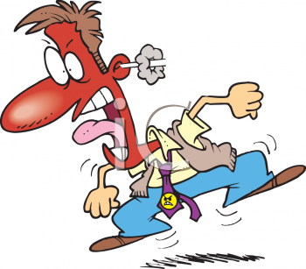

Understanding our own and other people’s stress, distress and anger

Slide 6

Stress and Distress at Work
Working w/ people can be challenging
We’re commonly under pressure, managing highly charged and complex situations, w/ little time and information
When in pain or unwell it increases people’s insecurities, neediness, agitation
They can feel under threat, anxious, scared, angry, stressed (fight or flight)
This can result in demanding behaviour or reduce their ability to clearly and calmly communicate what they need
We might consequently be pushed into our fight, fright or freeze response.

Slide 7
Stressful Events
Work
Personal
Burnout
Depersonalisation
(diminished empathy)
Low personal accomplishment
Emotional exhaustion
Psychological Distress
Physical Symptoms
Social Support
Self-care
Personal Hardiness
Stress Model Adapted from Kobasa et al.

Slide 8


A Trauma Lens…
“The PIE [Psychologically Informed Environment] originally arose out of the need to recognise and to work with the levels of emotional trauma that accompany, and in many cases precede, an individual becoming homeless”
Service Users
Staff
Notes:
Whilst retraumatisation can be unintentional and unanticipated, services who fail to acknowledge the role of trauma in people’s lives, and their consequent need for safety, mutuality, collaboration and empowerment, may inadvertently retraumatise, further reinforcing survivors’ needs for coping strategies that can become challenging for services, and for the individual.

Slide 9

What is a Psychologically Informed Environment (PIE) in a nutshell?
A PIE is any setting/service/organisation with a coherent psychological framework that holds trauma, mental health and wellbeing at the centre of its understanding and interventions.
Notes:
“The PIE [Psychologically Informed Environment] originally arose out of the need to recognise and to work with the levels of emotional trauma that accompany, and in many cases precede, an individual becoming homeless”

Slide 10
Psychological Awareness
Staff Training & Support
Roles, Rules & Responses
Spaces of Opportunity
Culture Learning & Enquiry
Five Key Strands of PIE
Reflective
Practice
Reflective
Practice
Relationships
Reflective
Practice
Reflective
Practice

Slide 11
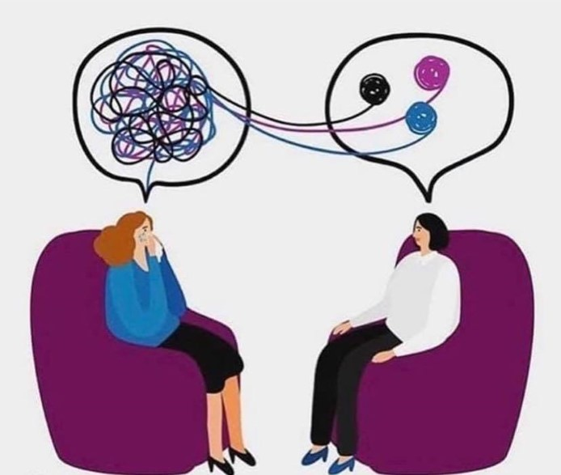
1) Psychological Awareness & Approach
Theoretical underpinning
Evidence-based approach
Centrality of understanding trauma and psychological needs
Consistency and coherence
Trauma Informed Care, strengths-based approach, attachment theory etc...
Including psychological ways of making sense of the work and understanding its impact
Notes:
Going to focus on Psychological framework.
This can seem the least inaccessible bit to people – but it doesn’t need to be and in fact is central to all the other bits.

Slide 12

2) Relationships – we are relational beings!
Relationships - the vehicle for facilitating change
Attachment – can be cause and solution
Consistent, Reliable, Familiar, Boundaried, Safe
Empowerment, choice, control, strengths-based
Safety (encompassing moral, physical, psychological, social and cultural safety)
Boundaries, roles, responsibilities,
Value and facilitate peer involvement
Recruitment (values based)
Policies and procedures (elastic tolerance)
Clients with complex needs are not excluded.

Slide 13

3) Staff Training & Support
Increase staff competencies and confidence
Support good self-care and model wellbeing practices
The service reflects on its working practices to support continuous improvement.
Reflective Practice
Case-based discussion / formulation spaces
Supervision
Specialist training (particularly on understanding and working with trauma).
Open door policy; honest conversations
Staff resilience increases. Burnout, turnover & absenteeism reduce.
Psychological Safety

Slide 14

4) The Environment and Spaces of Opportunity
Consider physical and emotional safety of your setting
Consider setting, layout and meaning/experience of different groups
How it is looked after? Good space for all to be in?
Allow space for connection, informal and impromptu engagement
Consider removal of physical barriers.
Consider lighting, heating, signage, furniture etc...
Co-created
Consideration around referrals, assessment, move-in, move-on
Do you have an environment champion or how to you encourage everyone to care for the setting?
Staff spaces, quiet time, reflection, desk access

Slide 15

5) Culture of Learning and Enquiry
Reflective practice cycle
Continuous measurement and adaptation
Existing tools, outcomes and KPIs
Formal Outcome Measures (Outcome Star, Wellbeing, Quality of Life)
Short surveys & questionnaires
Focus Groups & Qualitative Evaluation
Case Studies, stories, narratives
“Insanity is doing the same thing over and over and expecting different results.”

Slide 16

What keeps our wheels turning? Staff Support Structures
Debrief
Super-vision
Training
Role Model
Recruit
Processes
The Container
Notes:
What keeps our wheels turning?
Common types of support are (all involve foundation of reflective practice):
Clinical 1:1 supervision
Group reflective practice (generally more process orientated)
Group complex case formulation sessions (generally a mix of process/action orientated)
1:1 complex case formulation sessions
Peer mentoring
Informal peer support
When staff are supported appropriately they can respond by acknowledging emotion/pain/ reflect on unmet need for safety/respond by altering interaction style and environment where possible….this then decrease survivors feeling of being unsafe, increases control and decrease likelihood of violence and aggression
The elements of these different types of support should be driven to provide:
Acknowledge the impact of the work, supporting processing and reducing risk of burnout and vicarious trauma.
A study by Waegemaker Schiff and Lane (2016) reveal that about 25% of workers in the homeless were suffering from burnout and compassion fatigue to the point where job performance & quality of life was decreased. And 36% of workers reported symptoms of PTSD that very likely would result in a diagnosis of PTSD.
A place for staff feelings in relation to service users/resident to be heard, validate and processed
A space for staff to reflect, share skills, knowledge, resilience and resources
An opportunity to elaborate narratives of hope and compassion
A place to address compassion fatigue
A chance to consider the role of trauma and wider contextual factors are impacting on a individuals or groups behaviour
Reflective Practice:
Professional competence
Space to debrief
Integrate evidence with experience
Improve clinical reasoning and consequently patient care
Improve staff satisfaction and motivation
Support teamwork and management environmental pressure
For professional competence: Mann et al (2009) noted that the capacity to reflect is a key attribute for professional competence enabling 1) learning from experience, 2) integration of personal beliefs and values with those of the organization making them more self-aware and 3) better self-regulation of behaviour. RP groups also help staff develop critical thinking skills (Tanner, 2006).
To provide space to debrief: RP groups offer a protected space for staff to collectively process critical incidents and understand what best practice means in the context in which they work (Tanner, 2006). They reconstruct often stressful and emotive experiences for staff to allow them to view events less subjectively and in more pragmatic ways which can help their development and practice (Williams & Walker, 2002).
To integrate evidence with experience: RP groups support staff to apply “intuitive knowledge” to their practice (Mantzoukas, 2008) which may otherwise be ignored in an evidence driven healthcare context.
To improve clinical reasoning and consequently patient care: Many authors have suggested that “reflective healthcare practice” has value in improving patient care (Chinn & Jacobs, 1987; Johns, 1995; Landeen et al, 1995 cited in Cooke & Matarasso, 2005) which may be achieved by encouraging a move towards “relationship based practice” (Gilkerson, 2004). It can also make staff aware of the influence of power dynamics in the professional-patient relationship (Park-Taylor, Kim, Budianto, Pfeifer, Laidlaw, Sakurai and Pfeifer, 2009).
To improve staff satisfaction and motivation: Improved role satisfaction for staff is a benefit (Johns, 1995) which may be achieved through assisting staff in “perspective taking” (Larrieu & Dickson, 2009) and making meaning out of their roles within the wider system (Teekman, 2000). This may increase motivation for change (Walsh et al, 2004).
To support teamwork: RP provided in a multidisciplinary context may help forge links between groups of professionals and also nurture increased psychological awareness across disciplines (Johnston & Paley, 2013). It can help teams manage the pressures of the environment in which they work Gilkerson (2004).

Slide 17
Self-care in the care professions
Important to feel supported by colleagues and managers.
Recognise signs of compassion fatigue. Watch Boundaries. Use “Care-frontation” with each other
Have space to talk about difficult situations
Reflective Practice
Debrief after incidents
Supervision and peer support
Routine check-ins at the end of a shift
Think about your particular triggers for stress, distress and irritation.
Self Care Plan (Physical, Emotional, Spiritual, Intellectual, Social, Occupational, Environmental).
Who are your supports? What are the signs you are stressed? What helps? What doesn’t help?
Practice personal relaxation
Be offered & attend staff training
Read policies - to help & support you in managing difficult situations
Notes:
It is up to everyone to recognize signs and symptoms of compassion fatigue in each other
Apathy and lethargy = poor judgment and bad outcomes
Watch our boundaries
Use “Care-frontation” with each other
“You were a bit snippy on the phone.”
“That isn’t strengths-based language.”
“Your conversation sounded a little too friendly. I’m worried the boundaries might be blurred.”
“I am worried about you.”

Slide 18

Introducing aneemo
Health and social care training made simple
www.aneemo.com
The only online training platform dedicated to specialise staff training for the homelessness sector.

Slide 19

“In dealing with those who are undergoing great suffering, if you feel ‘burnout’ setting in, if you feel demoralized and exhausted, it is best, for the sake of everyone, to withdraw and restore yourself. The point is to have a long-term perspective.”
The Dalai Lama

Slide 20


Thank You
Dr Emma Williamson
Consultant Clinical Psychologist, Clinical Lead & Head of Service Psychology in Hostels Project, SLaM.
CEO Aneemo
@Dr_EWilliamson
Emma.williamson@slam.nhs.uk
emma@aneemo.com

