Slide 1

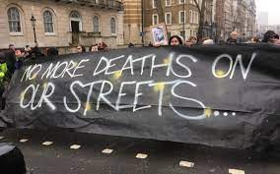
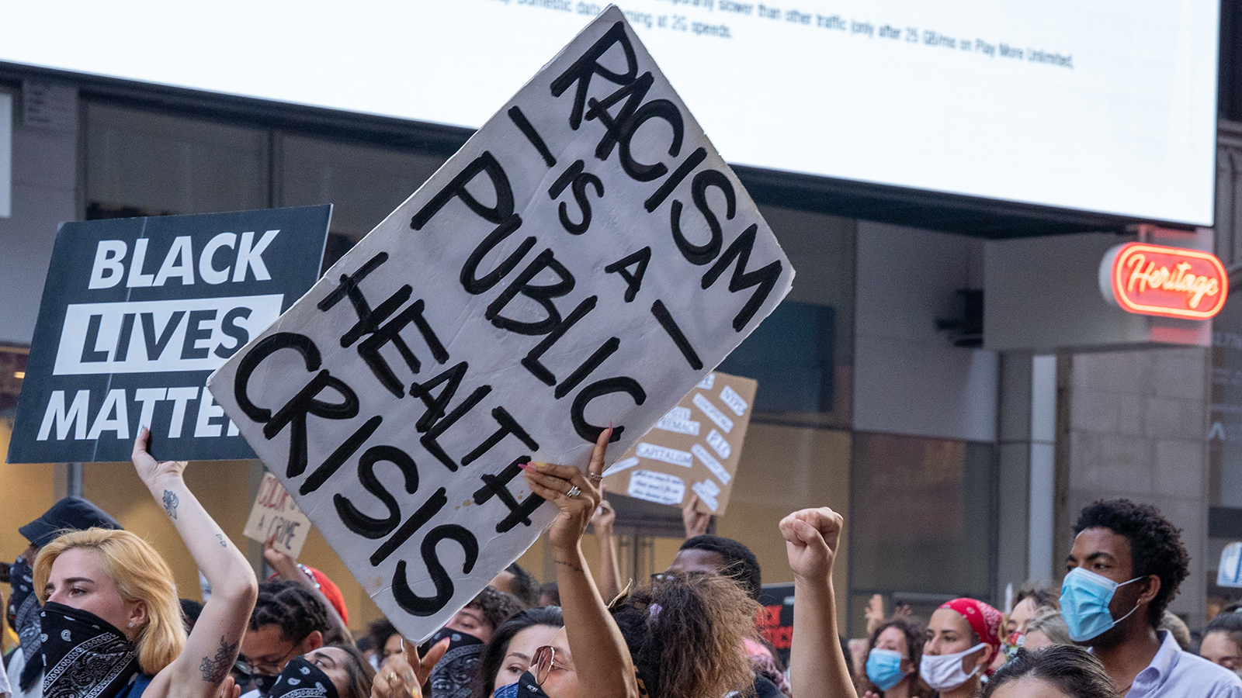
HOMELESSNESS RADICAL SAFEGUARDING TOOLKIT London Network of Nurses and midwives conference 10.06.2023

Slide 2
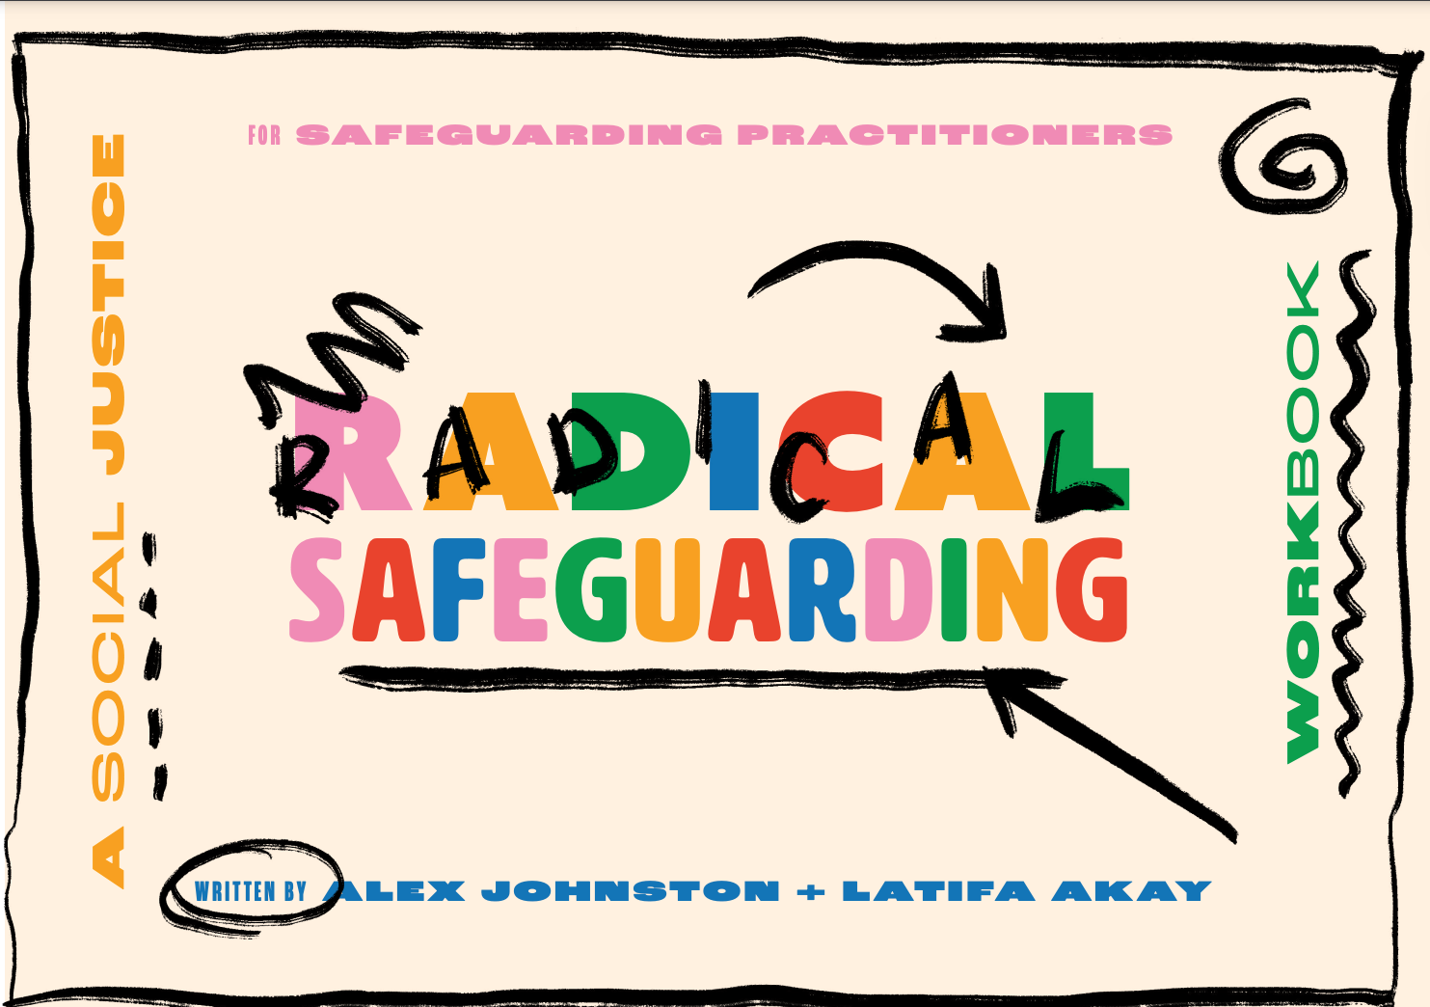
background
Aim: to create an anti-oppressive toolkit for people working with adults affected by homelessness & multiple disadvantage that builds on the principles of social justice movements
Lived-experience led
Informed by conversations with friends
Inspired by a toolkit created for Maslaha
Supported by Research in Practice

Slide 3
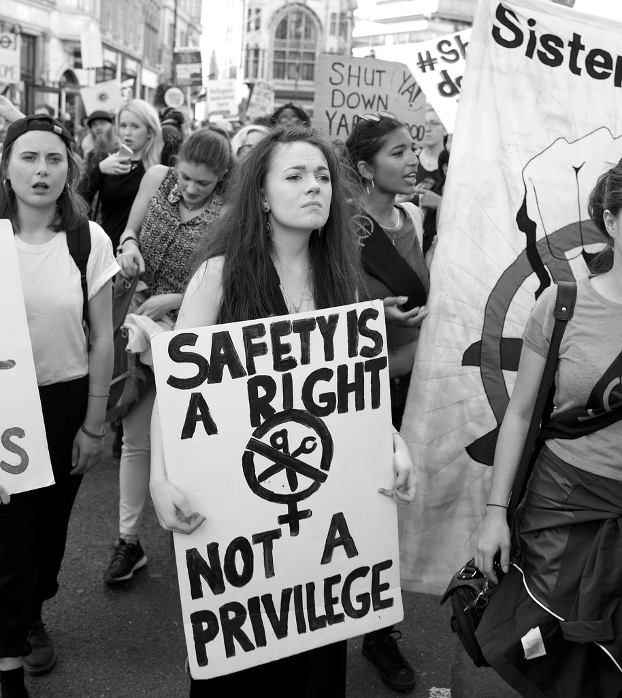
LEGAL CONTEXT
There are many laws that operate both positively and negatively in the lives of people who are homeless;
Care Act (2014)
Housing Act (1996) and Homelessness Reduction Act (2018)
Equality Act (2010)
Domestic Abuse Act (2021)
Anti-Social Behaviour, Crime and Policing Act (2014)
Immigration Rules
The law is a foundation, not a ceiling. How can we expand definitions and duties within the law in the interests of people affected by homelessness?
The law can and does change; often legislative change comes about because of social justice movement and developments in practice.
How legally literate are you at the moment? How could you learn more?
Notes:
Mention anti-social behaviour bill currently going through the House of Commons – anti-social behaviour legislation is proposed to be used to force people into social care and other support if they are living on the streets.

Slide 4
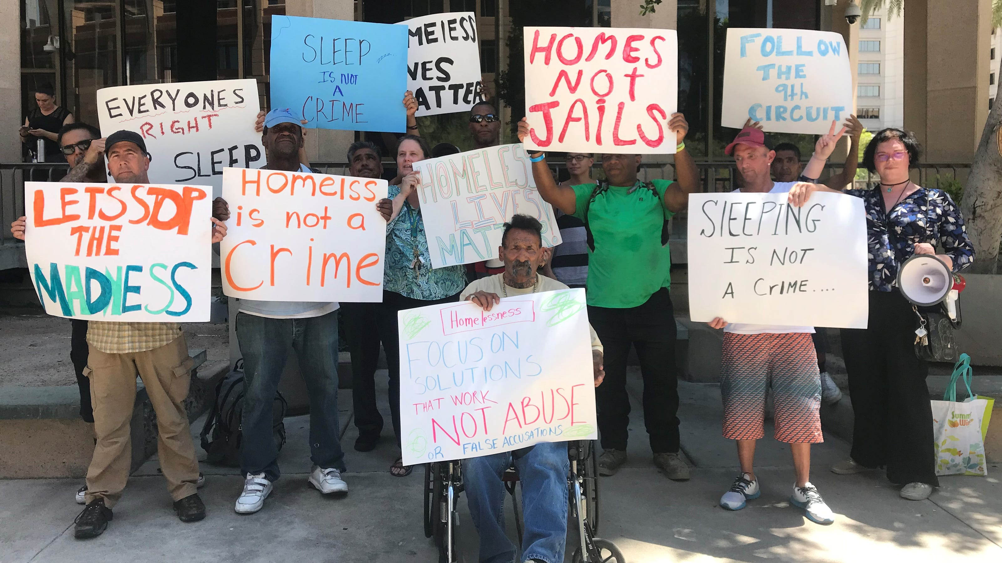
ANTI-OPPRESSIVE PRACTICE
Anti-oppressive practice has its practical foundations in social work.
Anti-oppressive practice means that we take account of the impact of power, inequality and oppression on people, and actively combat these in our work.
Anti-oppressive practice includes:
Recognising the personal, cultural and structural barriers that people face
Recognising how people’s personal characteristics are used to stereotype or limit them
Recognising our own characteristics and our own place in the culture and structure – and how this might impact on the other person
Working to understand someone’s experience of oppression, understand and appreciate their strengths, and empower them to realise their rights (Thompson 2016).
Source: Research in Practice – Supervision Change Project Tools
Notes:
Available at: https://www.local.gov.uk/sites/default/files/documents/Practice_Tool_9%20Anti-oppressive_practice%20WEB.pdf

Slide 5
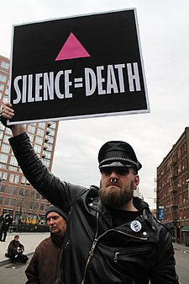
POWER
noun
the ability or capacity to do something or act in a particular way.
the capacity or ability to direct or influence the behaviour of others or the course of events.
Social justice movements often draw on both definitions of power in order to demand access to services, equal treatment or the right to certain protections or freedoms.
Where is power evident in your work? How does it affect you? How might power be experienced by the people we support? What responsibilities do we have because we are in positions of power?
Notes:
Silence=Death project (1987) 6 activists, became worldwide mantra for change. Movement demanding access to healthcare and equal treatment for HIV+ people – an example of how homophobia and racism had a direct impact on health and care (often for homeless and trans people specifically).
Watch Paris is Burning

Slide 6
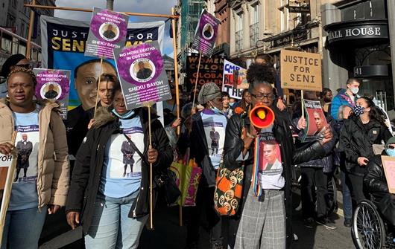
accountability
adjective
required or expected to justify actions or decisions; responsible.
able to be explained or understood.
Social justice movements frequently seek accountability for harm, caused accidentally or intentionally, against people who are vulnerable and in the care of statutory organisations.
They show us that race, gender, sexuality, disability and immigration status are all factors in the deaths of vulnerable people.
These campaigns, investigations and enquiries can take years. They show us the need for resilience, perseverance and honesty.
In what ways are we accountable to the people we support? In what ways are we accountable for our action and inaction? Do the people we support know how to hold services to account?
Notes:
UFFC – deaths in custody, detention and mental health inpatient facilities – 1839 deaths in or immediately following custody since 1990 (Inquest casework and monitoring).
Watch Injustice and Ultraviolence

Slide 7
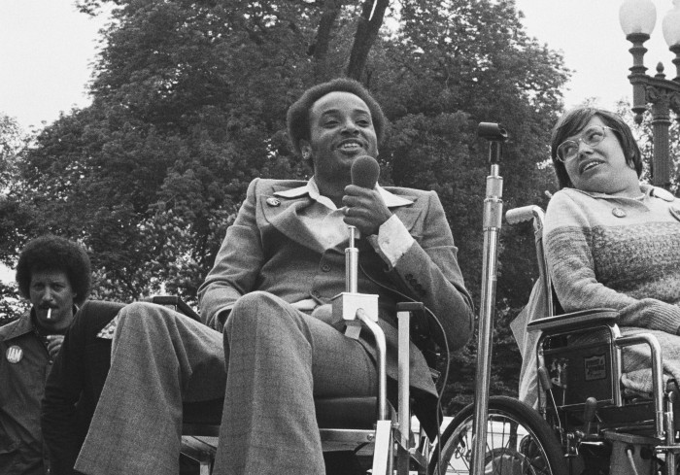
solidarity
noun
unity or agreement of feeling or action, especially among individuals with a common interest; mutual support within a group.
Social justice movements invite us to recognise how our fates are tied together and, to collaborate to achieve change. It also reminds us that this is long-term and rarely straightforward.
Notes:
The ‘504 Sit-In’ (1977) is a good example of solidarity in and between social justice movements – black panthers and disability justice movements. This is Brad Lomax and Judy Heumann, co-leaders of the sit-in.
Watch Crip Camp

Slide 8
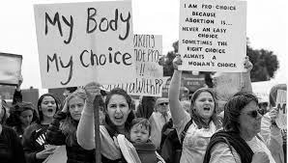



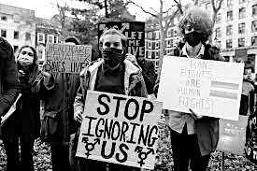

autonomy
noun 1. the quality or state of being self-governing
2. self-directing freedom and especially moral independence
3. a self-governing state
Social justice movements encourage us to think about the ways that personal characteristics and experiences can be used to remove freedom and autonomy, to deny or restrict help, or to justify harm caused.
They also encourage us to look for the patterns and contradictions in who is able to make choices, including unwise ones, and who is prevented from doing so.
An intersectional approach recognises the particular importance of autonomy for people who have historically been denied it; women, trans folk, prisoners, refugees, survivors of abuse, those with institutional experiences etc.
How does autonomy help us to think differently about phrases such as ‘lifestyle choice’ and ‘non-engagement’? How do we build more and better choices? How do we support people to take control of their lives?
Notes:
Commitments to choice, control and person-centred care are not new in social work. But is that the same as autonomy?

Slide 9
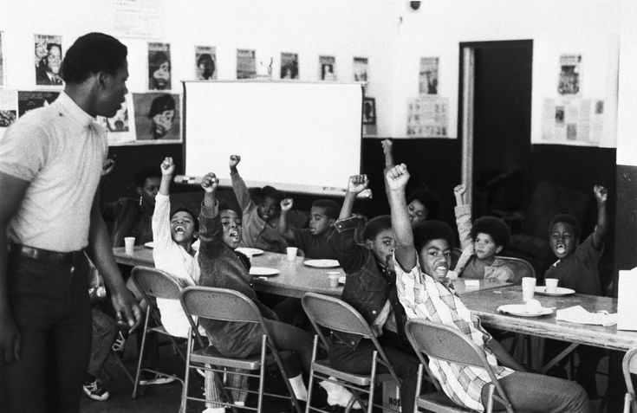
RADICAL LEARNING
Radical learning looks at how power shows up in groups, it is co-created, encourages action, draws from our lived experience and is accessible and creative.
What could making space for new ideas, difficult conversations & appreciative enquiry bring to our approach to organisational neglect?
Notes:
bell hooks – ‘education as the practice of freedom’
Angela Davis – activist and teacher
MLK, teacher,
Nelson Mandela, teacher
Maya Angelou, teacher

Slide 10

A toolkit of what?
Reflections on homelessness experiences
Things to read and watch
Quotes
Reflective Activities
Facts and figures
Creative projects
Practical tools for groups and 1:1’s
Alternative & forgotten histories
Places to visit

Slide 11
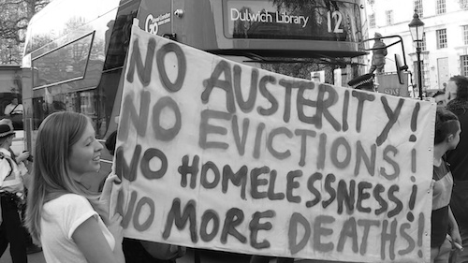
THANK YOU
If you’d like to be added to the toolkit mailing list e-mail me: gillktaylor@gmail.com

