Slide 2
New NICE Guidance on Integrated Health & Social Care for People Experiencing Homelessness LNMM NICE NUGGETS Professors Al Story & Andrew Hayward (apologies)
National Institute for Health and Care Excellence (2022) Integrated health and social care for people experiencing homelessness.
Available from https://www.nice.org.uk/guidance/ng214

Slide 3
Committee Members
Chair – Rachel Jones (Deputy Regional Director, Public Health England, Yorkshire)
Topic Advisors – Professor Andrew Hayward, Professor Al Story,
PHE Topic Advisor - Jezz Stannard
Committee
Lay members - Karen Kavivi Harrison, Shannon Johnstone, Jonathan Rees N
Primary Health Care – Andrea Williamson
Health care worker with mental health and substance abuse experience – Colm Gallagher
Emergency Dept clinician – Shona Duffy
Secondary care health or social care worker with experience of discharge planning - Claire McGinley
Front line worker with experience in outreach - Colin Morrison
Front line worker with experience from day centres - Tilly Scott
Senior professional working in a hostel - Gareth Webber T
Community social worker – Fran Busby
Director or assistant director in local authority with experience in housing and social care - Simon Cribbens
Senior manager from a voluntary sector organisation - Rebecca Pritchard
The guideline referred to in this presentation was produced by the National Guideline Alliance for the National Institute for Health and Care Excellence (NICE). The views expressed in this presentation are those of the authors and not necessarily those of NICE.”

Slide 4
CONCLUSION
Parachute use did not reduce death or major traumatic injury when jumping from aircraft in the first randomized evaluation of this intervention. However, the trial was only able to enroll participants on small stationary aircraft on the ground, suggesting cautious extrapolation to high altitude jumps.
https://www.bmj.com/content/bmj/363/bmj.k5094.full.pdf

Slide 5
General principles of providing services
Recommendations for planners & commissioners
Recommendations for service delivery
Research Recommendations

Slide 6
Proportionate universalism - the resourcing and delivering of universal services at a scale and intensity proportionate to the degree of need

Slide 7
Proportionate universalism
Recognise that more effort and targeted approaches are often needed to ensure that health and social care for people experiencing homelessness is available, accessible, and provided to the same standards and quality as for the general population
Recognise the importance of longer contact times in developing and sustaining trusting relationships between frontline health and social care staff and people experiencing homelessness
What is the effectiveness and cost effectiveness of longer health and social care contacts compared with usual care for people experiencing homelessness?

Slide 8
Proportionate universalism
Consider reducing caseloads and lengthening contact time for health and social care practitioners working with people experiencing homelessness to enable them to use approaches that sustain engagement with services
Recognise that people experiencing homelessness often need additional resources and a more targeted service delivery to: ensure that resources are allocated according to need and disadvantage; take into account the social determinants of health; improve long-term outcomes and address health inequalities.
Consider moving people up waiting lists for health and social care appts if they are experiencing homelessness because their circumstances may mean they are at higher risk of deterioration and premature death

Slide 9
Is reducing caseloads (and thus increasing time spent with clients) per practitioner cost-effective?
Compared 35 cases per practitioner over 5 years to: -
1/9 y 1 ➔ 1/15 y 2 & 3 ➔ 1/30 y 4 ➔ 1/35 y 5
Lower caseload strategy = increase in discounted costs of £4,018 per case over 5 years
QALY gain would need to be 0.20 per case over 5 years or 0.04 per case each year for a lower caseload strategy to be considered cost-effective (threshold £20,000 per QALY gained)

Slide 10
Is reducing caseloads (and thus increasing time spent with clients) per practitioner cost-effective?
Value of improved outcomes offsets additional staff costs required to deliver lower caseloads

Slide 11
Supporting engagement
Promote engagement by providing services that:
are person-centred, empathetic, non-judgmental
aim to address health inequalities
are inclusive and pay attention to the diverse experiences of people using the service
Ensure that people experiencing homelessness with multiple health or social care needs are not excluded from services because of restrictive eligibility criteria. For example, people with mental health problems are not denied access to mental health services because they have drug and alcohol treatment needs
Consider using psychologically informed environments and trauma-informed care. Recognise that people’s behaviour and engagement with services is influenced by their traumatic experiences, socioeconomic circumstances and previous experiences of services
What is the effectiveness and acceptability of clinical psychology-led psychologically informed environments and psychological approaches for people experiencing homelessness?

Slide 12
Sustaining engagement
Promote shared decision making, building self-reliance and using strengths -based approaches to care (also known as assets-based approaches)
Recognise that people experiencing homelessness, especially those with experience of rough sleeping, need services that provide a long-term commitment to care to promote recovery, stability and lasting positive outcomes
Consider the likely benefits of using long-term contracts for providers
Ensure that people can access help when needed, including through emergency care, and avoid policies that withdraw support and close cases after a standard duration, unless a safe transfer of care to another service has been agreed with the person or the person agrees that they no longer need the service

Slide 13
Sustaining engagement
Give priority to building a relationship of trust, for example by:
taking time with the person, particularly at the beginning of the relationship
being prepared to meet in an informal setting, such as a park or café (with appropriate lone worker policies in place)
having regular contact
ensuring consistency of practitioner, so that they meet with 1 person or a small team
aiming to meet immediate expressed needs to encourage long-term engagement
Consider providing ‘open-door’ services that people can self-refer to and access after any initial support ends, to reduce the risk of becoming homeless again because of unmet health, care and support needs

Slide 14
Supporting re-engagement
Be aware that some people experiencing homelessness may find it difficult to look after themselves because of their circumstances and may find services difficult to engage with. For people who disengage from or refuse health and social care services:
• actively support re-engagement
• enable people to re-engage with services at the same point as they left, if appropriate
Do not penalise people experiencing homelessness for missing appointments, for example, by discharging people from the service. Consider seeking specialist help, such as peer supporters or independent advocates, to support the person to attend appointments and re-engage with care after missing appointments

Slide 15
Integration
Commissioners of health, social care and housing services should work together to plan and fund integrated multidisciplinary health and social care services for people experiencing homelessness, and involve commissioners from other sectors, such as criminal justice and domestic abuse, as needed
Work together to strategically plan and deliver health and social care across larger areas, recognising that people move between areas
Work with other relevant services, such as prison and probation services and domestic abuse services

Slide 16
Multidisciplinary teams
Provide care through specialist homelessness multidisciplinary teams across sectors and levels of care, tailored according to local needs
Homelessness multidisciplinary teams should act as expert teams, providing and coordinating care across outreach, primary, secondary and emergency care, social care and housing services

Slide 17
Multidisciplinary teams
Homelessness multidisciplinary teams may include:
experts by experience
healthcare professionals with relevant specialist expertise (for example, drug and alcohol treatment, mental health, primary care, emergency care, palliative care)
social workers
housing options officers or homelessness prevention officers
outreach and homelessness practitioners
voluntary and charity sector professionals
staff with practical expertise in accessing benefits and entitlements for people experiencing homelessness

Slide 18
Multidisciplinary teams
Homelessness multidisciplinary teams should:
identify people experiencing homelessness through outreach or when they present to health and social care services
support mainstream providers to identify and refer people to the homelessness multidisciplinary team
undertake and support assessments for safeguarding, physical and mental health, alcohol and drug treatment needs, and social care, including informing Care Act assessments
support mainstream providers to ensure safe, timely and appropriate hospital discharge and engagement with onward care

Slide 19
Multidisciplinary teams
Homelessness multidisciplinary teams should:
Offer person-centred case management by a designated practitioner within the multidisciplinary team and ensure continuity of care for as long as it is needed by the person
Offer wraparound health and social care support that encompasses the person's needs, including:
physical health
mental health and psychological support (such as psychological therapies)
physical rehabilitation (such as occupational therapy and physiotherapy)
drug and alcohol treatment
social care
palliative care
communication support
practical support, such as help with benefits, housing and referral for legal advice.

Slide 20
Lived experience
Involve peers (experts by experience) in delivering and designing services, for example by:
directly delivering health and social care interventions, for example, as part of outreach
providing a user perspective to influence the design and development of services
providing training for health and social care staff
carrying out participatory research and data collection, for example, to support service audits, needs assessments and quality improvement

Slide 21
Addressing language, literacy and digital divide
Ensure that paper or digital forms needed to access health or social care or to get help with NHS costs are readily available and that people are supported to fill them in, including providing translation when needed
Ensure that people experiencing homelessness can access online health and social care information and are supported to use online services, for example by providing internet access at places where people experiencing homelessness spend time, such as day centres or hostels.

Slide 22
Information
Work with health and social care providers to improve recording of housing status so that the information can be used by services to:
best meet people's needs and
plan, audit and improve services

Slide 23
GP registration
Ensure that there are processes to:
support people experiencing homelessness to register with a GP
and
document and address any problems with GP registrations for people experiencing homelessness
Primary care service providers should ensure that people without an address can register with a GP practice, in line with the NHS Primary medical care policy and guidance manual

Slide 24
Outreach
Take health and social care services to people experiencing homelessness by providing multidisciplinary outreach care in non-traditional settings, such as on the street, hostels or day centres
Offer outreach services that include support for people who:
have primary healthcare needs
have drug and alcohol treatment needs
have mental healthcare needs
fear engaging with services, for example, because of previous negative experiences from providers, discomfort using male-dominated services or concerns about eligibility including immigration status
may lack mental capacity or need support to recognise their care needs and engage with providers

Slide 25
Outreach
Use outreach to identify health problems earlier, promote health and support engagement with care, for example by:
supporting access to national screening programmes
assessing people for long-term conditions, infectious diseases and mental health needs
providing preventive health opportunities, such as vaccination, drug and alcohol treatment services, harm minimisation, smoking cessation and nutrition advice

Slide 26
Outreach…
eliminates most access barriers faced by people experiencing homelessness
brings a level of flexibility that is not possible in traditional healthcare services
builds trust and a strong connection with the service provider
helps prevent people falling through the safety net of health and social care

Slide 27
Assessing Individual Needs
Assess the health and social care needs of the person experiencing homelessness. When carrying out the assessment:
take into account their capacity, rights to autonomy and self-determination, and any safeguarding issues and
avoid unnecessary and potentially distressing repetition of their history if it is already on record
involve peers or advocates as appropriate

Slide 28
Assessing Individual Needs
Include in the assessment:
A comprehensive assessment of the person’s physical and mental health needs (including acute and long-term conditions) and social care needs. This should take into consideration their housing and benefits situation, bearing in mind the need to address health inequalities, and be responsive to diversity, and inclusion needs.
Asking if the person has children or dependents and assessing how this affects their needs.
Understanding the historical context of their situation, including past psychological trauma and experience of services.
Use the multidisciplinary assessment to inform the local authority-led care and support needs assessment, under the Care Act 2014

Slide 29
Assessing Individual Needs
In assessments to inform a health and social care plan for people who might benefit from high levels of support, use a multidisciplinary approach to enable a comprehensive and holistic assessment of their needs, involving:
the person, and their advocate if one is nominated or appointed
input from professionals with specialist expertise and practitioners who have detailed knowledge of the person's health and social care needs, including staff working in homelessness and housing services.
Use hospital admissions as an opportunity to offer a comprehensive, holistic needs assessment, including referral, if indicated

Slide 30
Support through transitions
Homelessness multidisciplinary teams or leads should support people experiencing homelessness through transitions between settings (such as the street, hostels, Housing First and other supported housing, hospital, mental health services, social care, residential or community drug and alcohol treatment, and custody) and consider providing time-limited intensive support, which includes:
having a key practitioner coordinating care
building a relationship of trust
providing links to services in the community
gradually lowering the intensity of support, as appropriate

Slide 31
Support through transitions
Clinical teams, working with hospital discharge teams and specialist homelessness multidisciplinary teams, where available, should have procedures to:
minimise self-discharge and
prevent discharge to the street
If self-discharge or discharge to the street happens, review the circumstances and implement learning

Slide 32
Intermediate Care
Provide intermediate care services with intensive, multidisciplinary team support for people experiencing homelessness who have healthcare needs that cannot be safely managed in the community but who do not need inpatient hospital care. These may be for people who are:
discharged from hospital (step-down care)
referred from the community who are at acute risk of deterioration and hospitalisation (step-up care)

Slide 33
Housing with health and social care support
These recommendations are for commissioners and service providers working together across health, social care and housing services.
Recognise that providing accommodation suitable for the person's assessed health and social care needs can support access to and engagement with health and social care services and long-term recovery and stability
Provide wraparound health and social care support that is flexible to the person's changing needs and circumstances, and helps them maintain suitable accommodation
What structural and systems factors help or hinder commissioning and delivery of wraparound health and social care that is integrated with housing, for people experiencing homelessness?

Slide 34
Housing with health and social care support
Recognise the need for a range of accommodation types that are suitable for the varied needs of people experiencing homelessness, such as self-contained accommodation and accommodation with specialist onsite support for people who are particularly at risk or who might otherwise benefit from higher levels of support.
Be aware that moving to independent accommodation in the community with tenancy responsibilities can be an extremely challenging, stressful and isolating experience for some people. Provide emotional and practical support for as long as it is needed

Slide 35
Safeguarding
Designate a person to lead on safeguarding the welfare of people experiencing homelessness, including engagement and face-to-face practical safeguarding support
Commissioners and service providers should support health and social care staff to understand and apply laws relevant to people experiencing homelessness and who are in need of safeguarding. This should include ensuring that they can recognise signs of abuse and neglect (including self-neglect) and how to make a safeguarding referral

Slide 36
Long term care
Recognise that some people experiencing homelessness experience frailty at an earlier age (both physical and cognitive) than the general population and their long-term care should be tailored to meet this
Ensure that people experiencing homelessness who are assessed as frail and in need of social care and support get long-term care packages, including residential care or supported housing, irrespective of their age
If a person experiencing homelessness is likely to be approaching the end of their life, for example, if death would not be unexpected in 6 to 12 months, discuss palliative care needs with the person and the multidisciplinary team, and provide coordinated palliative care to meet the person's needs

Slide 37
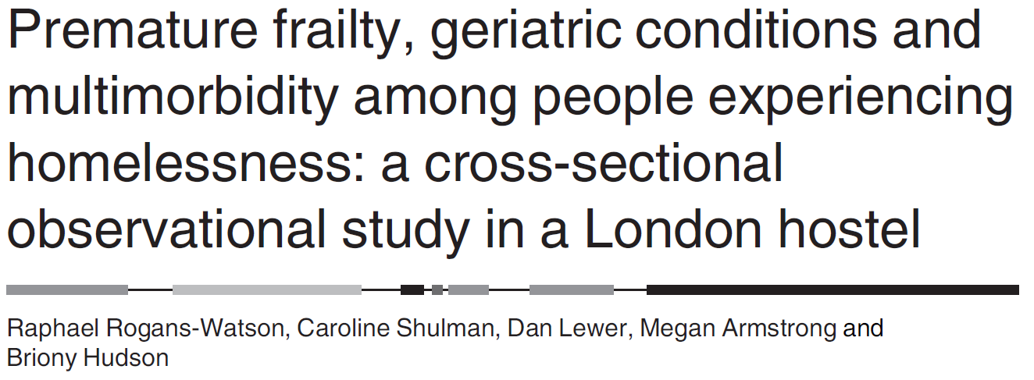
Cross-sectional observational study – 33 PEH - mean age of 55.7 years (range 38–74).
Frailty defined according to five criteria in Fried’s phenotype model and multimorbidity as the presence of two or more long-term conditions (LTCs)
Compared with the general population

Slide 38
Frailty identified in 55% and pre-frailty in 39%.
Mean frailty score 2.6/5, comparable to 89-year-olds in the general population.
All participants had multimorbidity
Average of 7.2 LTCs (range 2–14)
far exceeds the mean for even the oldest people in the general population

Slide 39
A needs-based rather than age-based approach is essential for appropriate assessment of this population to reduce health inequities

Slide 40
Premature aging and frailty are common among people experiencing homelessness with multiple and complex needs, so care and support should be based on assessed need, not biological age.

Slide 41
Nuggets
Commission for equity
Integrated MDTs / Leads, Larger Footprints, Sustainable contracts
Lived Experience at the heart of everything
MECC – Comprehensive needs assessment – Stick with people
Legal Literacy – Rights & Safeguarding
Improve identification / harmonise data / measure outcomes

Slide 42
Nuggets
Outreach - Take health and social care services to people
Prevention / Early Dx / Long-term conditions
Support through transitions – Critical Time Interventions
Provide intermediate care services with intensive MDT support
Accommodation based on assessed health and social care needs
Long term care – Based on assessed needs NOT biological age – Frailty, Brain injury – cognitive impairment

Slide 43
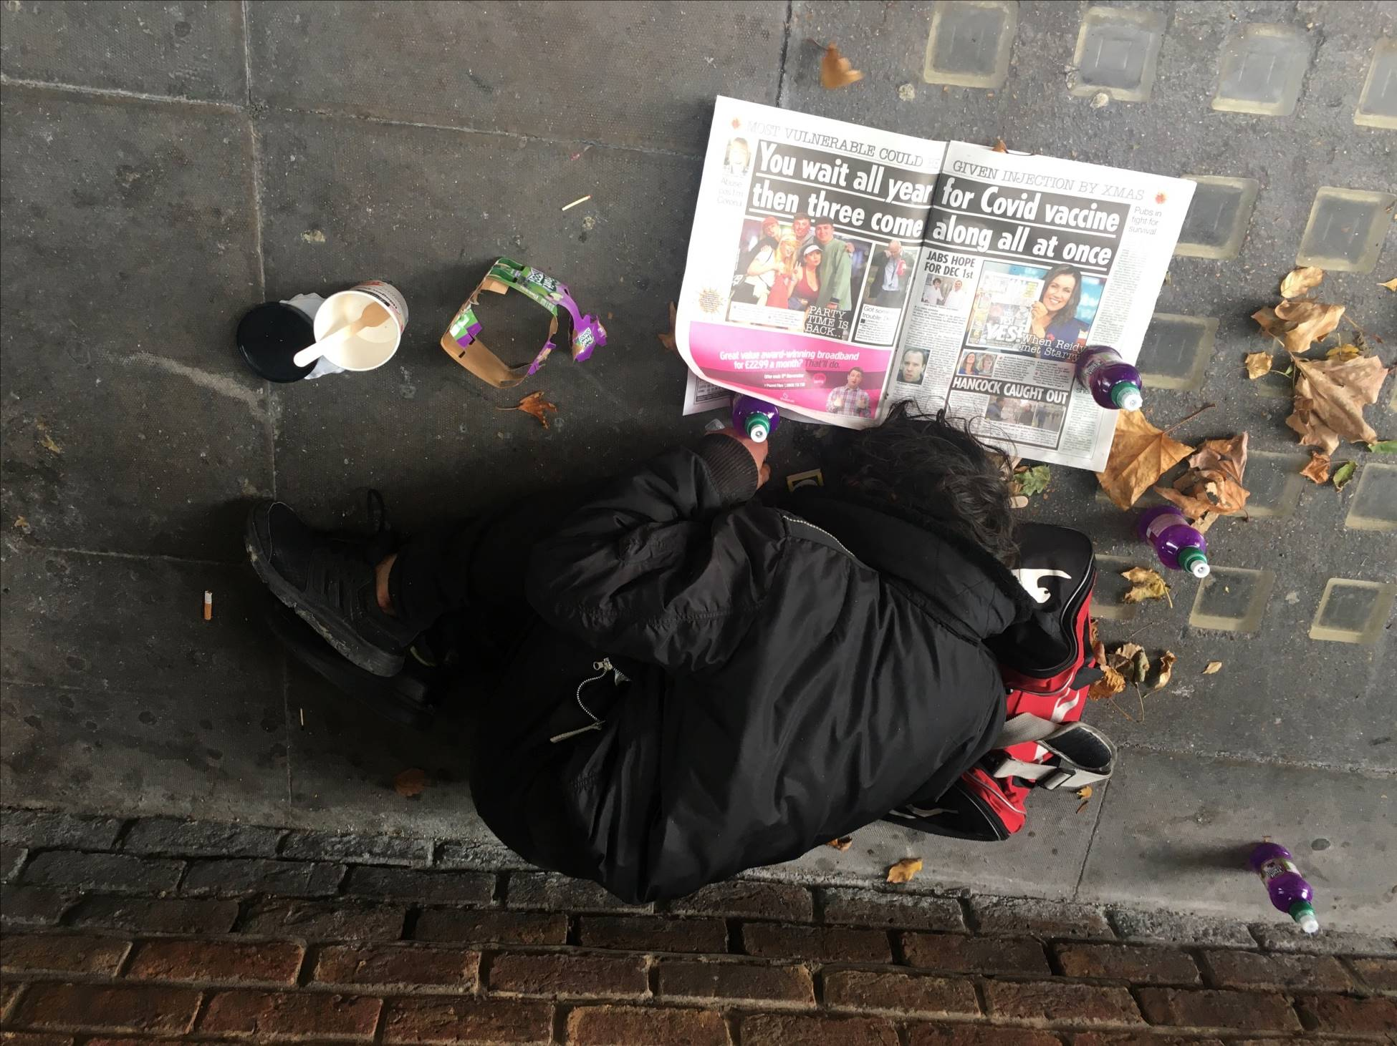

Slide 44
Inequality

Slide 45
Do they Deserve?
DESERVOMETER®
Find out Now
Point of care eligibility testing for all your clients

Slide 46
Go Forth Demand - Advocate - Implement Stronger Together
Thank you

